Slide 1
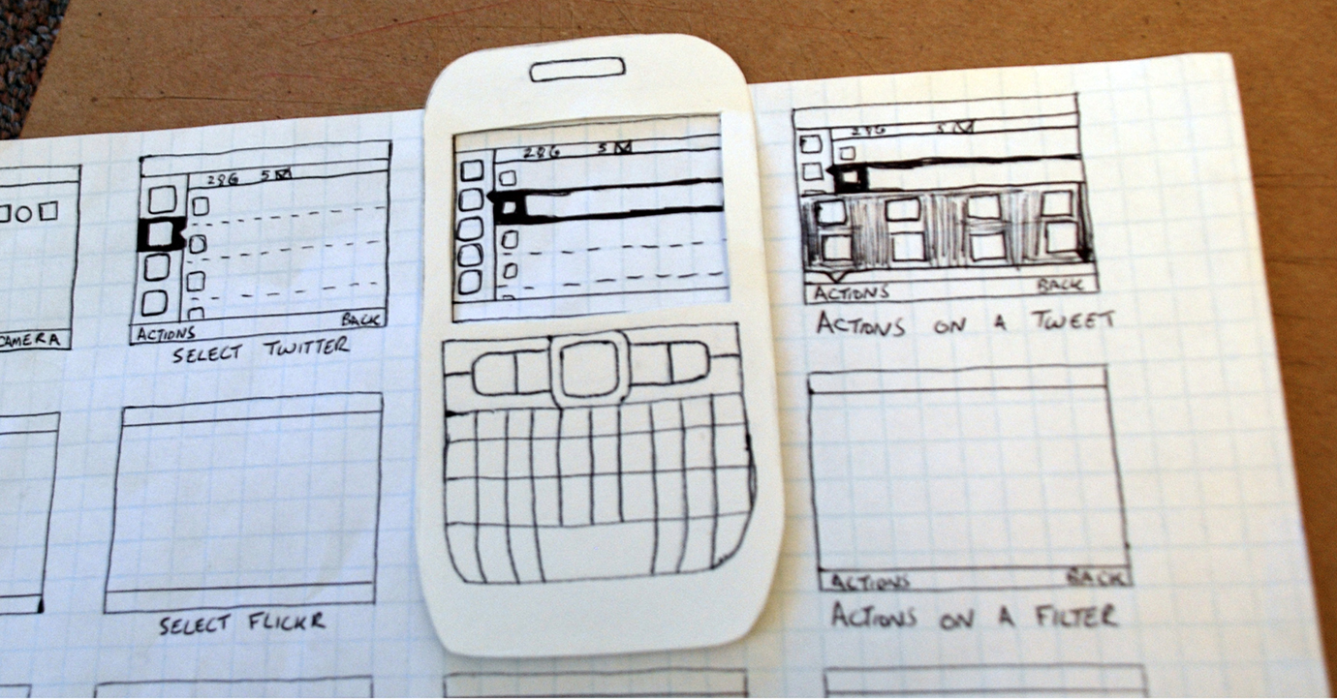
Design Principles, Conceptual Models and Prototypes
Based on:
Y. Rogers, H. Sharp and J. Preece. Interaction Design: Beyond Human-Computer Interaction. Willey, 2011.
on-line lecture material: http://www.id-book.com

Slide 2
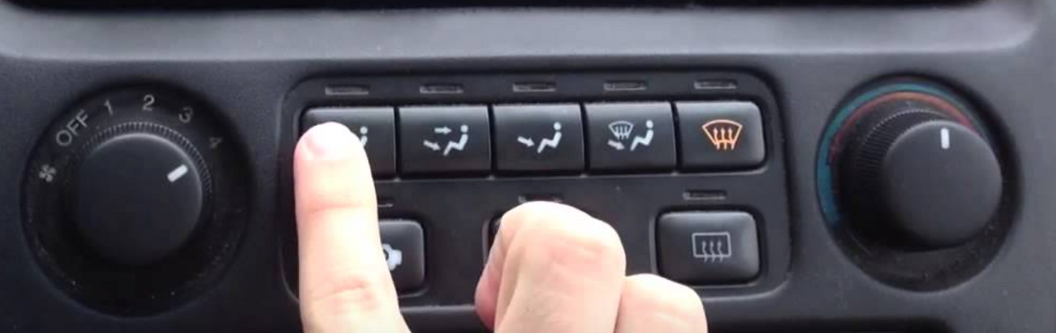
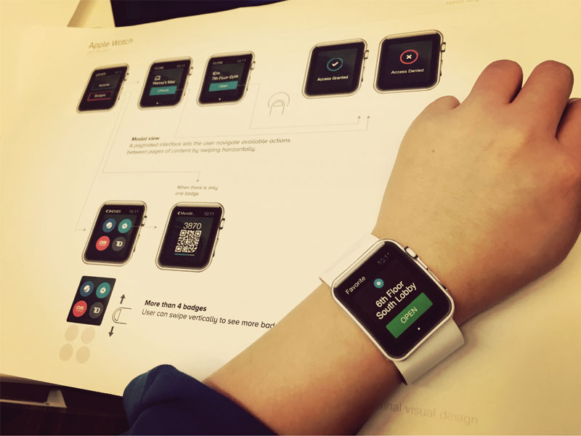
Overview
Design Principles
  Visibility
  Consistency
  Feedback
The Design Process
  Conceptual Model
  Metaphors
Interaction Types
  Instructing
  Conversing
  Manipulating and Exploring
Prototyping
http://www.id-book.com

Slide 3
Design Principles

Slide 4

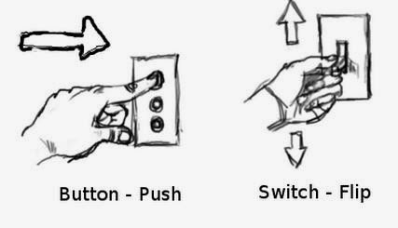
Design Principles
Abstractions for thinking about different aspects of design
Derived from a mix of theory-based knowledge, experience and common-sense
We shall discuss;
  Visibility
  Feedback
  Use of Constraints
  Consistency
  Effective use of Affordances
  Later on: effective use of Metaphors
http://www.id-book.com

Slide 5
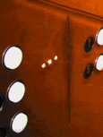
Visibility
This is a control panel for a hotel elevator
How does it work?
Push a button for the floor you want?
Nothing happens. Push any other button? Still nothing. What do you need to do?
It is not visible as to what to do!
From: www.baddesigns.com
http://www.id-book.com

Slide 6
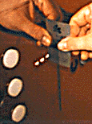
Visibility
Well: you need to insert your room card in the slot by the buttons to get the elevator to work!
How would you make this action more visible?
make the card reader more obvious
provide an auditory message, that says what to do (which language?)
provide a big label next to the card reader that flashes when someone enters
make relevant parts visible
make what has to be done obvious
http://www.id-book.com

Slide 7
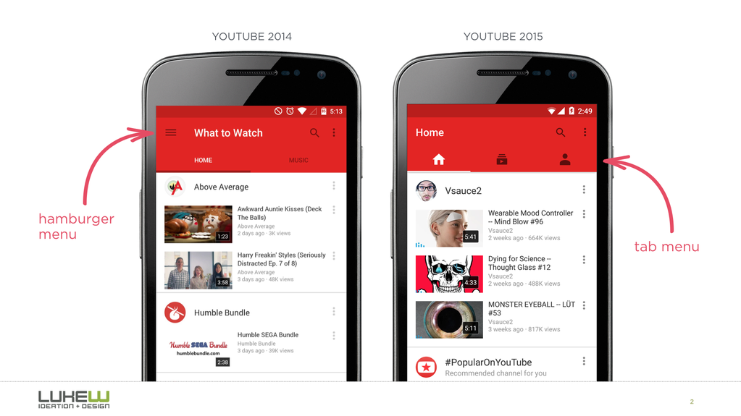
Visibility
Hamburger menus are easy to implement and save space. BUT, studies show that making menu items visible increases engagement, user satisfaction and revenue.
http://medium.com

Slide 8
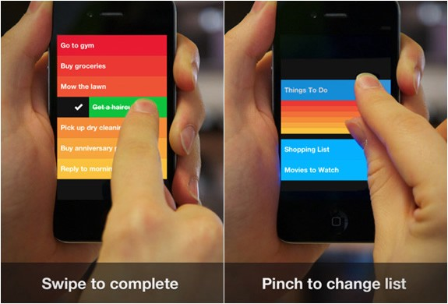
Visibility
Gestures are hidden commands i.e. they are not visible. Gestures are also not always consistent between apps. Unless it’s fundamental to your app (e.g. swiping left/right on Tinder), think hard before relying on gestures.
http://medium.com

Slide 9
Feedback
Sending information back to the user about what has been done
Includes sound, highlighting, animation and combinations of these
  e.g. when an onscreen button is clicked, it produces a sound or red highlight feedback
Also includes messages that informs the user of the state of the interaction.
Your application has now been submitted.
OR
An error occurred while submitting the application – please click here to return to the submission page.
“click”
http://www.id-book.com

Slide 10
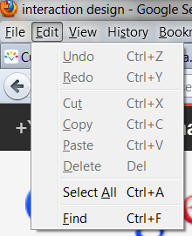

Constraints (restrictive)
Restricting the possible actions that can be performed
Helps prevent user from selecting incorrect options
Physical objects can be designed to constrain things
e.g. only one way you can insert a key into a lock
http://www.id-book.com

Slide 11
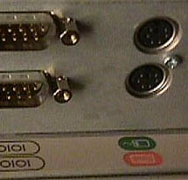
Constraints (Information-Based)
Can come in the form of representations that direct the user.
Need to be unambiguous though.
Where do you plug in the mouse and keyboard?
How would you solve this using an information-based constraint?
From: www.baddesigns.com
http://www.id-book.com

Slide 12


Constraints
(i) A provides direct adjacent mapping between icon and connector
(ii) B provides color coding to associate the connectors with the labels
What practical reasons may have forced the manufacturers to produce such a problematic design.
From: www.baddesigns.com
http://www.id-book.com

Slide 13
Consistency
Design interfaces to have similar operations and use similar elements for similar tasks
For example:
  The order of menus in applications: [File, Edit, View etc.]
  The shortcut keys for editing
Main benefit is consistent interfaces are easier to learn and use

Slide 14
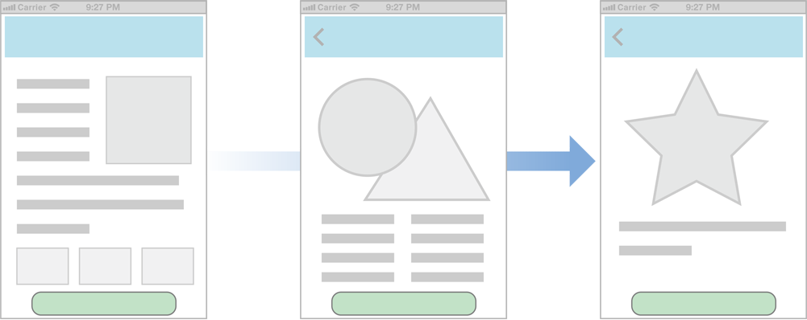


Internal and External Consistency
Internal consistency refers to designing operations to behave the same within an application
  Same across functions of the application
  Does not change with time.
External consistency refers to designing operations, interfaces, etc., to be the same across applications and devices
  May be challenging if different designers are involved.
Most users will understand these icons
Since they have used them before
Most users will be confused
http://www.id-book.com

Slide 15
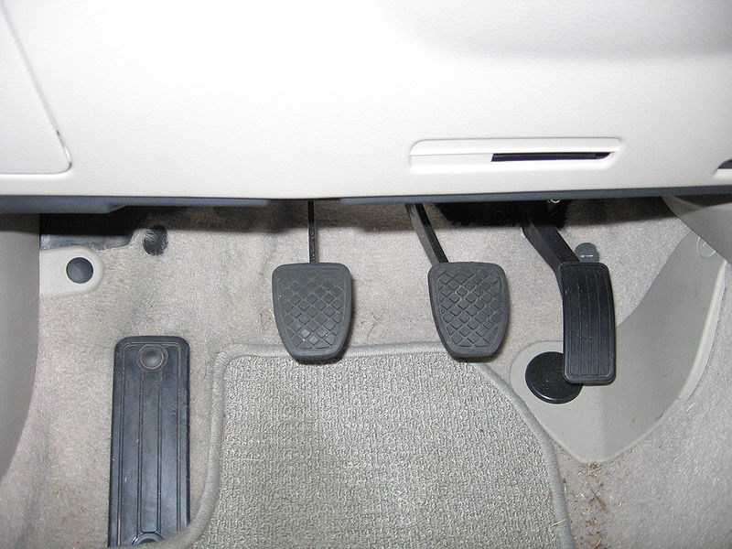
External Consistency
Key pads
(a) phones, remote controls
1
2
3
Car pedals!
4
5
6
7
8
9
0
(b) calculators, computer keypads
7
8
9
4
5
6
1
2
3
0
http://www.id-book.com

Slide 16
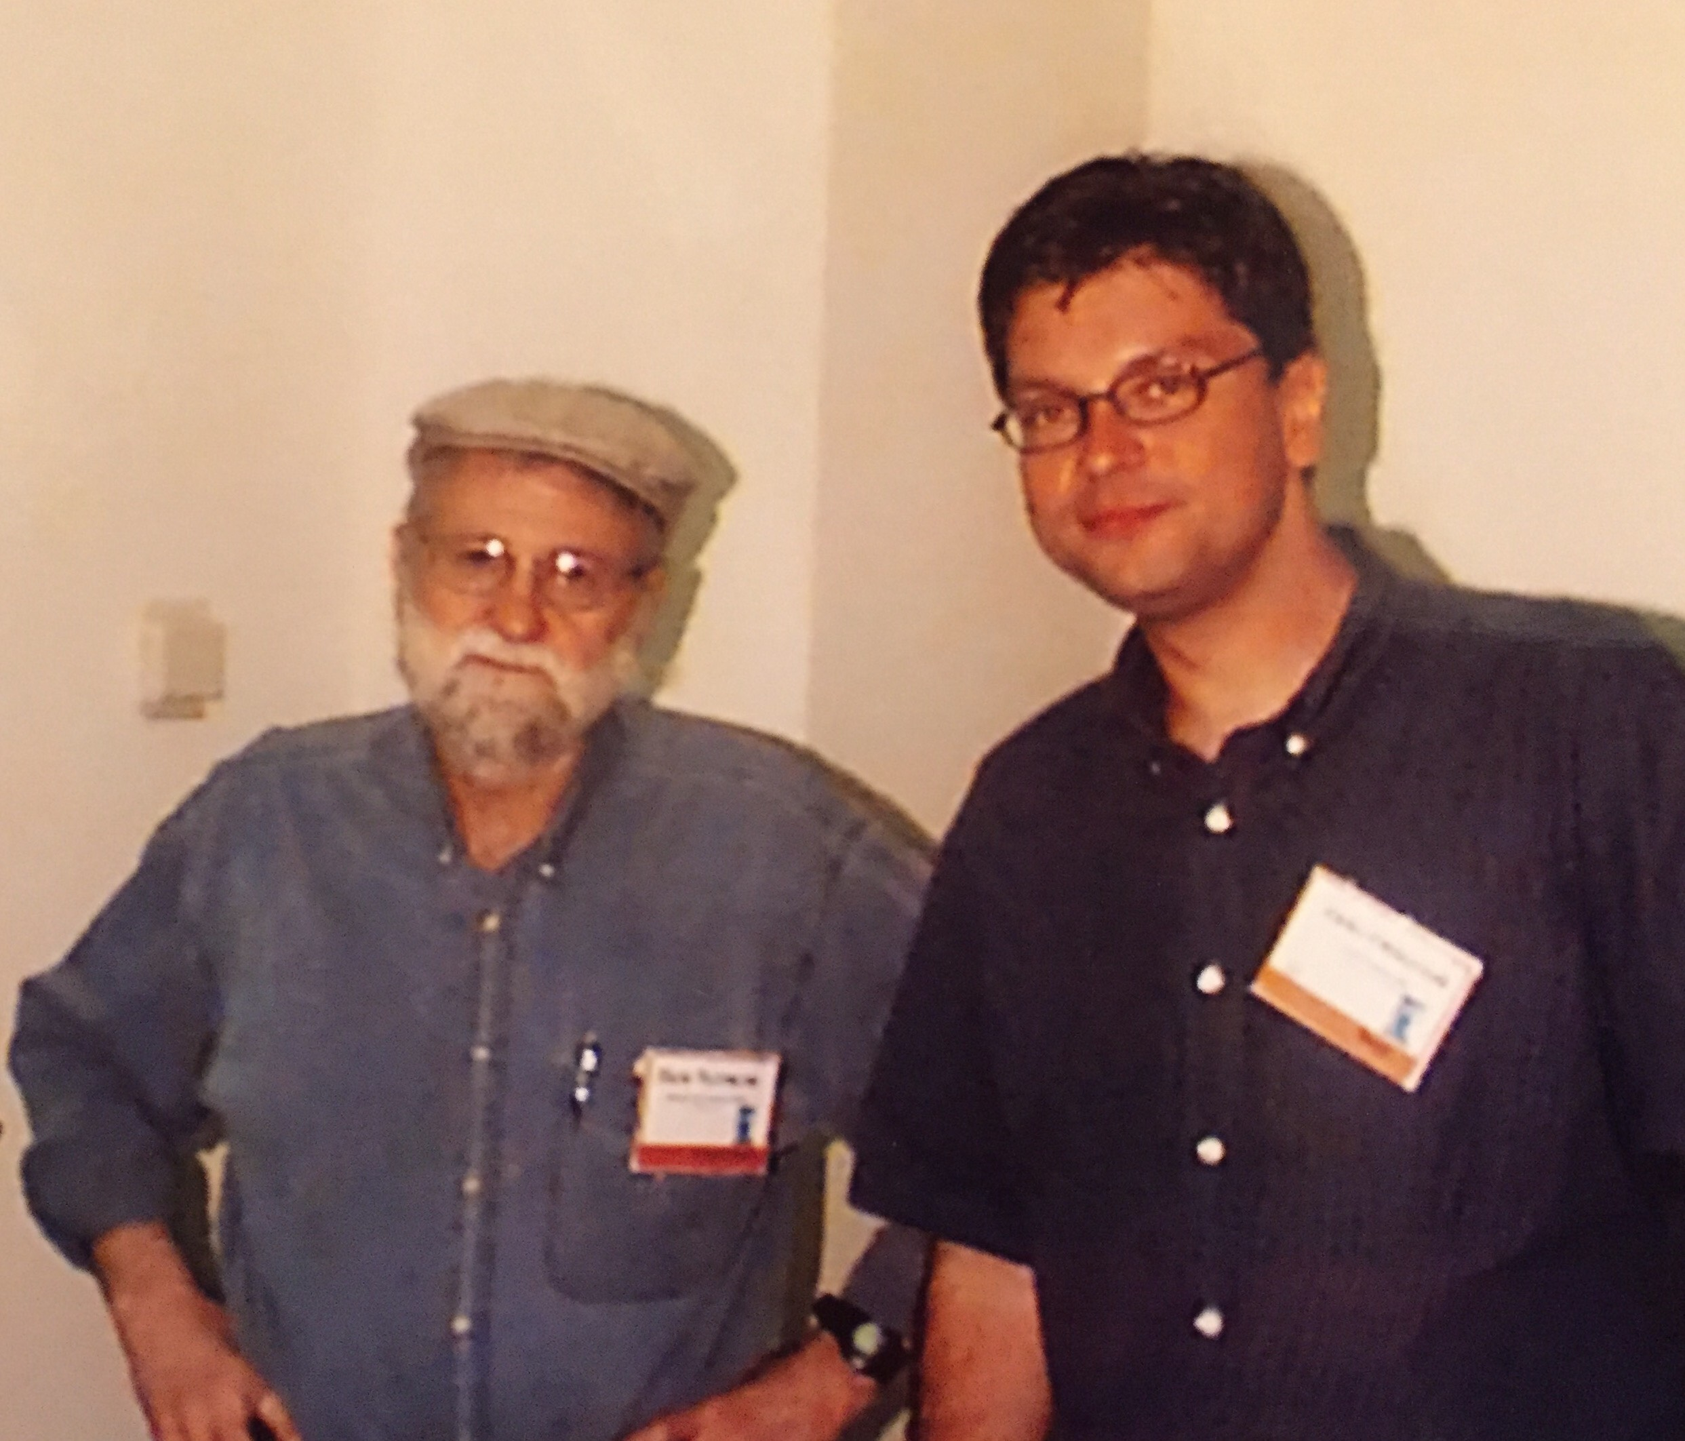
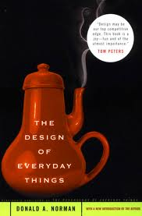
Use of Affordances
Refers to an attribute of an object that allows people to know how to use it.
  e.g. a mouse button invites pushing, a door handle affords pulling
Norman (1988) used the term to discuss the design of everyday objects
Has since been popularised in interaction design to discuss how to design interface objects
  e.g. scrollbars to afford moving up and down, icons to afford clicking on
Real vs. perceived affordances
Related to the ecological theory of perception (more later)
http://www.id-book.com

Slide 17
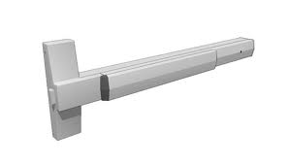
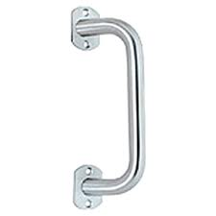
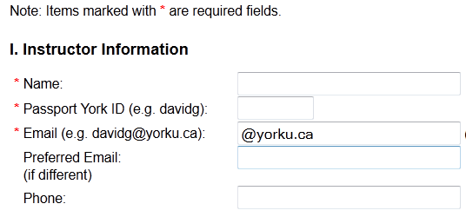

Affordance Examples
Real affordances:
door handles
versus
Perceived affordances:
form controls
Affords editing
(engraved)
Affords pressing
(shadowed as if raised)
Does not afford editing (flat)

Slide 18
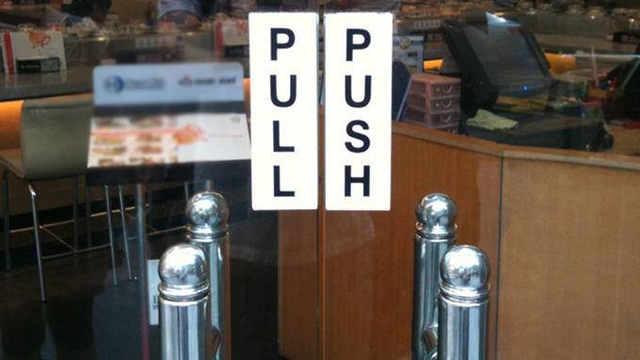
Affordances

Slide 19
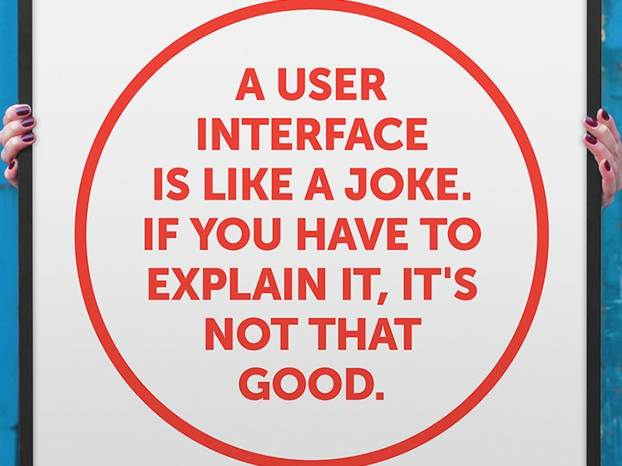
Affordances

Slide 20
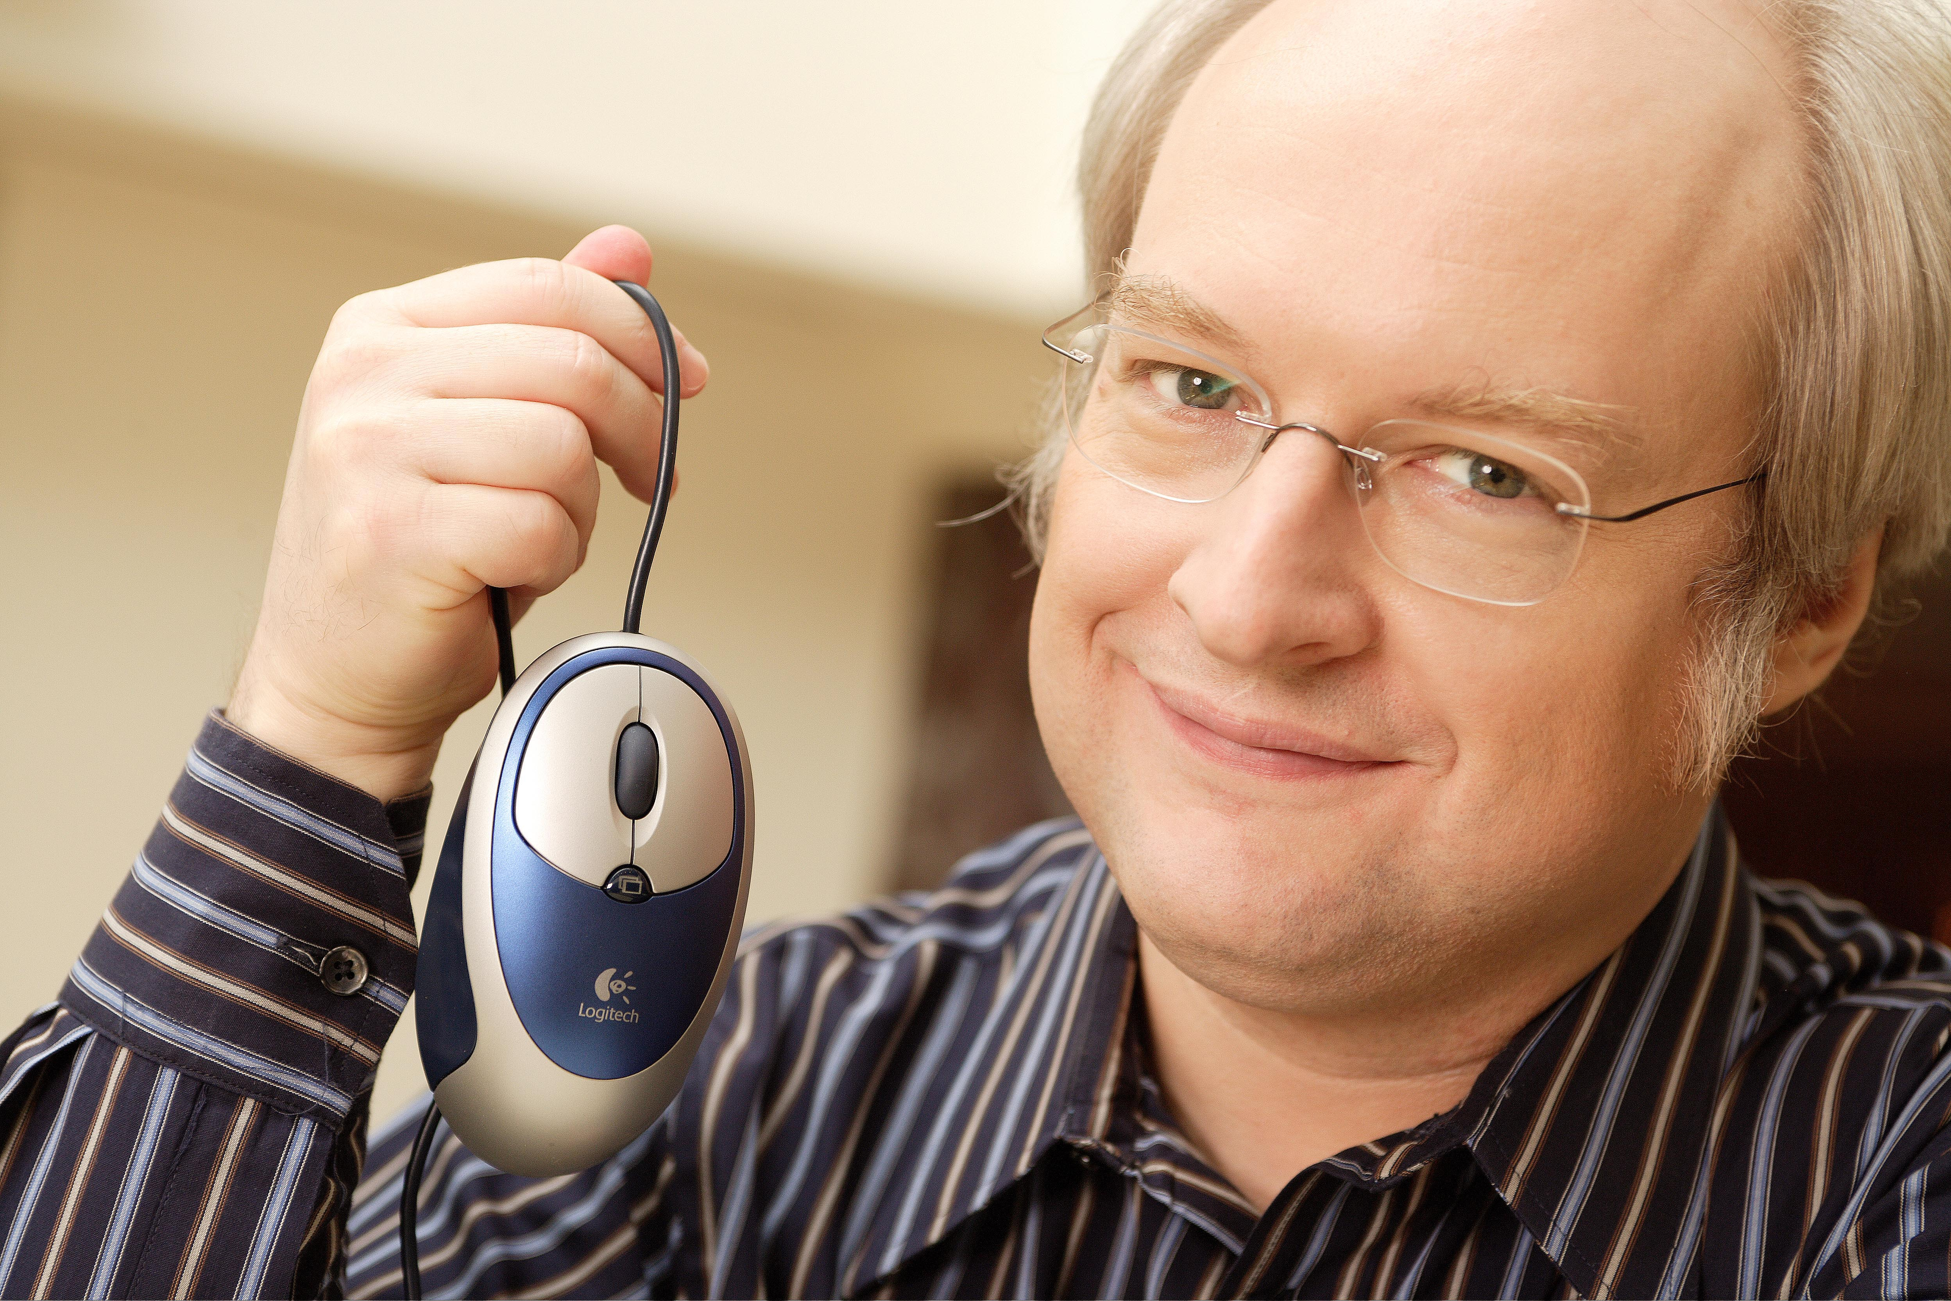
An alternative way to think about usable designs: nielsen’s usability principles
Similar to design principles, except more prescriptive
Used mainly as the basis for evaluating systems
Provides a framework for heuristic evaluation
http://www.id-book.com

Slide 21
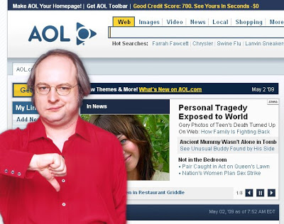
nielsen’s usability principles (2001)
Visibility of system status
Match between system and the real world
User control and freedom
Consistency and standards
Help users recognize, diagnose and recover from errors
Error prevention
Recognition rather than recall
Flexibility and efficiency of use
Aesthetic and minimalist design
Help and documentation
http://www.id-book.com

Slide 22
Conceptual Modeling

Slide 23
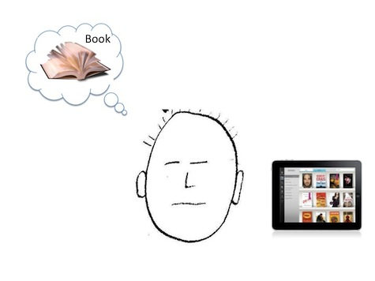
From problem to design
Having a good understanding of the problem space can help inform the design space
  e.g., what kind of interface, behaviour, functionality to provide
Requirements:
  A set of functional goals for the system i.e. what kinds of tasks the users want to perform
  A set of usability goals that are most important for the particular case.
  A set of experience goals that are relevant to the system.
Next step: define the conceptual model
  “a high-level description of how a system is organized and operates.” (Johnson and Henderson, 2002, p. 26)
  How the designers want the users to understand the system.
  How the designers themselves will understand the system.
http://www.id-book.com
Notes:
23

Slide 24


Mental model vs conceptual model
  A mental model is the representation that a person has in his mind about the object he is interacting with. Usually based on past experience with similar objects.
  A conceptual model is the actual model that is given to the person through the design and interface of the actual product. It’s the model of the application that the designers want users to understand.
  If both mental and conceptual models match closely, the interface will likely be intuitive and easy to use.
Susan M. Weinschenk. 2011. 100 Things Every Designer Needs to Know About People
Notes:
24

Slide 25
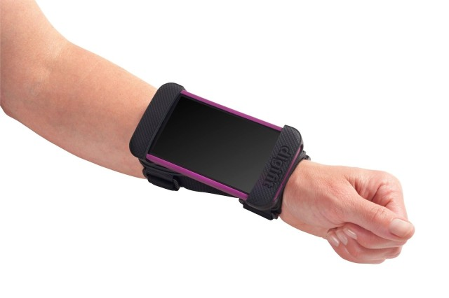
Mental model vs conceptual model
  If a user’s mental model of an Apple watch is a small, iPhone strapped to his wrist, he would find it intuitive and understand its limitations.
  If the user’s mental model is that it’s similar to watches he has seen before, he may be disappointed that the time is not always visible and that the battery life is measured in hours instead of years.
What if Apple had named it the iPhone nano?
Would this have changed the conceptual model?
Would this new conceptual model change the user’s mental model?
Susan M. Weinschenk. 2011. 100 Things Every Designer Needs to Know About People
Notes:
25

Slide 26

What is a conceptual model?
Why Do we need it?
A structure outlining the central idea as well as the concepts and the relationships between them.
Why not start with the nuts and bolts of design?
  Architects and interior designers would not think about which colour curtains to have before deciding where the windows will be placed in a new building
  Enables “designers to straighten out their thinking before they start laying out their widgets”
  Provides a working strategy and a framework of general concepts and their interrelations
E.g. “Uber for laundry”
Understood quickly – there is an app, you request service, someone comes to your location, they probably take your laundry and bring it back clean.
http://www.id-book.com
Notes:
26

Slide 27

Helps the design team
Designers focus on how the conceptual model will be understood by users.
  E.g. Fast, inexpensive laundry that is easy to schedule
Prevents focusing on details too early.
  E.g. Will they take the laundry away and clean it, or will they wash the laundry at the client’s house?
Establish a set of common terms they all understand and agree upon.
  E.g. Wash means cleaned, but not ironed or folded
Reduce the chance of misunderstandings and confusion arising later on.
  E.g. Do users expect dry-cleaning services to be included?
http://www.id-book.com
Notes:
27

Slide 28
Main components of a conceptual model
Major metaphors and analogies that are used to convey how to understand what a product is for and how to use it for an activity.
  E.g. The Rolex of Remote Controls – understood as an expensive, but well-made remote control. A remote to brag about.
Concepts that users are exposed to through the product
  E.g. The remote control has Netflix and YouTube buttons – probably means easy one-touch access to those services
The relationships between the concepts
  E.g. Arrow-shaped buttons increment or decrement
The mappings between the concepts and the user experience the product is designed to support
  E.g. The concept of one-button YouTube viewing could be marred by the actual design which requires signing in each time.
http://www.id-book.com
Notes:
28

Slide 29
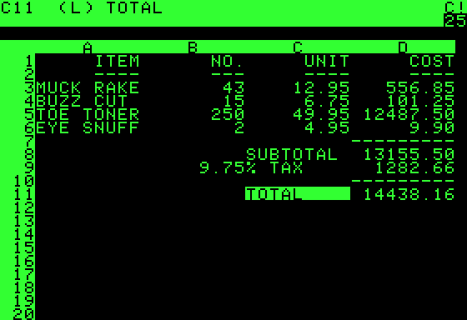
A classic conceptual model:
VisiCalc: the first spreadsheet app (1979)
Metaphor:
  The ledger sheet
Concepts:
  Columns, rows,
  totals
  Interactive and
  computational
Effect:
  Intuitive: accountants
  would get it
  immediately
  Greatly extending
  what accountants
  and others could do
http://www.id-book.com
Notes:
29

Slide 30
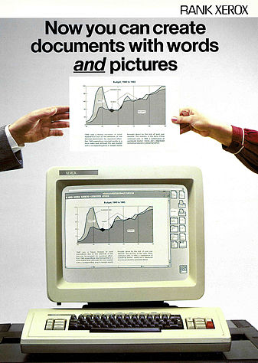
Another classic
8010 Star office system targeted at workers not interested in computing
Spent several person-years at beginning working out the conceptual model
Simplified the electronic world, making it seem more familiar, less alien, and easier to learn
Johnson et al (1989)
http://www.id-book.com
Notes:
30

Slide 31
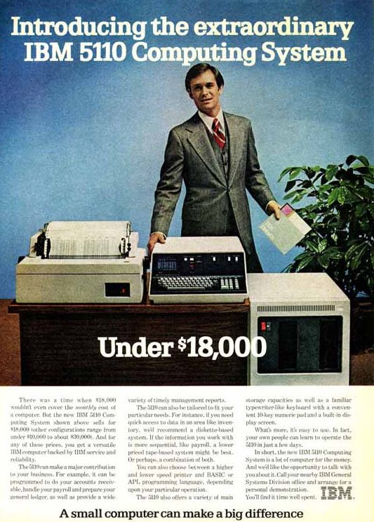
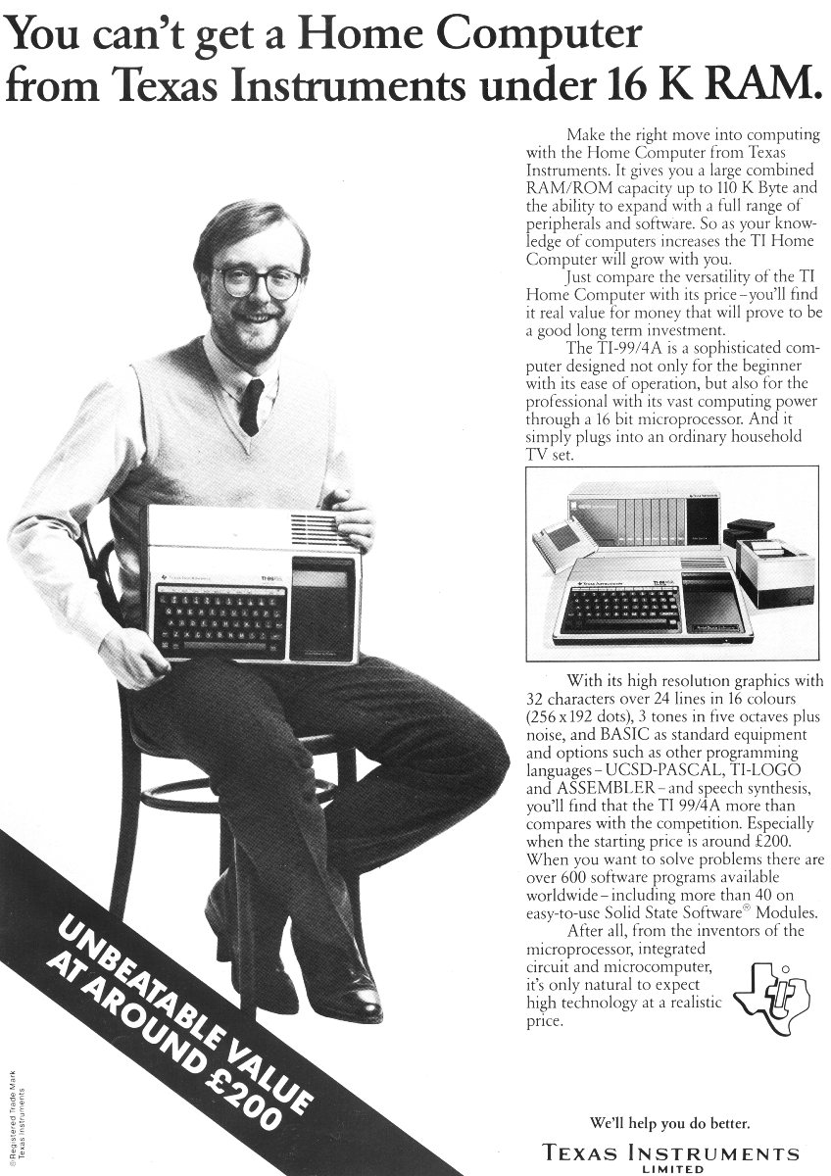
Computers and Ads NOT focusing on what an average office worker wants in a computer
http://www.id-book.com
Notes:
31

Slide 32
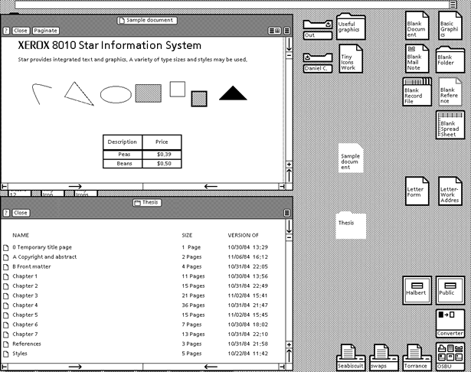
The Star interface (1981)
http://www.id-book.com
Notes:
32

Slide 33

Interface metaphors
Designed to be similar to an aspect of a physical entity but also has own properties.
  e.g. “desktop”, search “engine”, “folder”, “trash”
Exploit user’s familiar knowledge, helping them to understand unfamiliar aspects of the interface
Also: people find it easier to learn and talk about what they are doing at the computer interface in terms familiar to them.
http://www.id-book.com
Notes:
33

Slide 34
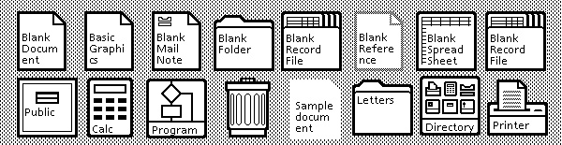
Benefits of interface metaphors
Makes learning new systems easier.
Helps users understand the underlying conceptual model.
Can be innovative and enable the realm of computers and their applications to be made more accessible to a greater diversity of users.
http://www.id-book.com
Notes:
34

Slide 35

Problems with interface metaphors (Nelson, 1990)
Break conventional and cultural rules
  e.g., trash bin placed on desktop
Can constrain designers in the way they conceptualize a problem space
Conflict with design principles
Forces users to only understand the system in terms of the metaphor
Designers can inadvertently use bad existing designs and transfer the bad parts over
Limits designers’ imagination in coming up with new conceptual models
http://www.id-book.com
Notes:
35

Slide 36

Styles of Interaction
Instructing
Conversing
Manipulating
Exploring

Slide 37
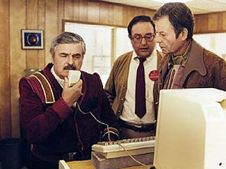
Instructing
Where users instruct a system by telling it what to do
  e.g., tell the time, print a file, find a photo
Very common interaction type underlying a range of devices and systems
A main benefit of instructing is to support quick and efficient interaction
  good for repetitive kinds of actions performed on multiple objects
http://www.id-book.com
Notes:
37

Slide 38
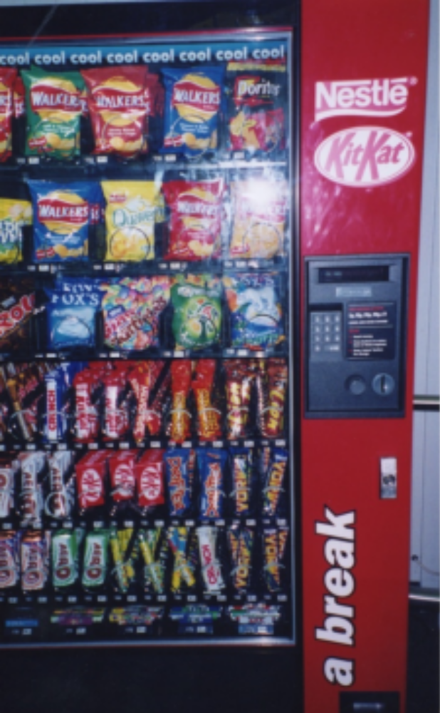
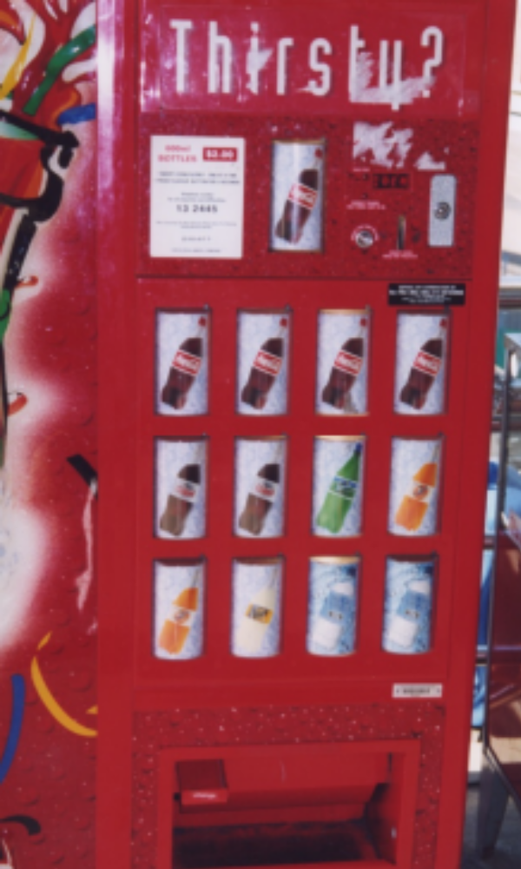
Instructing a vending machine
How are the conceptual models different?
http://www.id-book.com
Notes:
38

Slide 39
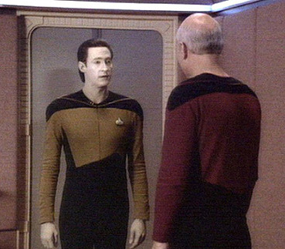
Conversing
Like having a conversation with another human.
Differs from instructing in that it more like two-way communication, with the system acting like a partner rather than a machine that obeys orders.
Ranges from simple voice recognition, menu-driven systems, set-up “wizards” to more complex ‘natural language’ dialogues
Examples include search engines, advice-giving systems and help systems
http://www.id-book.com
Notes:
39

Slide 40
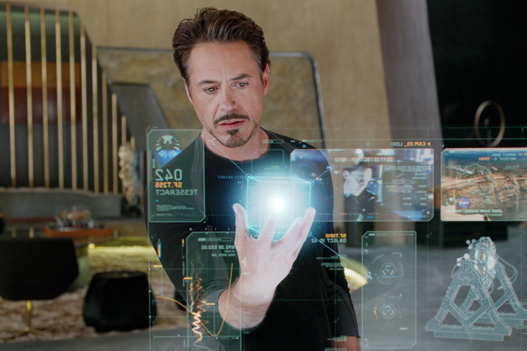
Manipulating
Exploit’s users’ knowledge of how they move and manipulate in the physical world
Virtual objects can be manipulated by moving, selecting, opening, and closing them.
  E.g. diagram editors or CAD systems
More advanced: tagged physical objects (e.g., bricks, blocks) that are manipulated in a physical world (e.g., placed on a surface) can result in other physical and digital events
Proposes that digital objects be designed so they can be interacted with analogous to how physical objects are manipulated.
Assumes that direct manipulation interfaces enable users to feel that they are directly controlling the digital objects.
http://www.id-book.com
Notes:
40

Slide 41
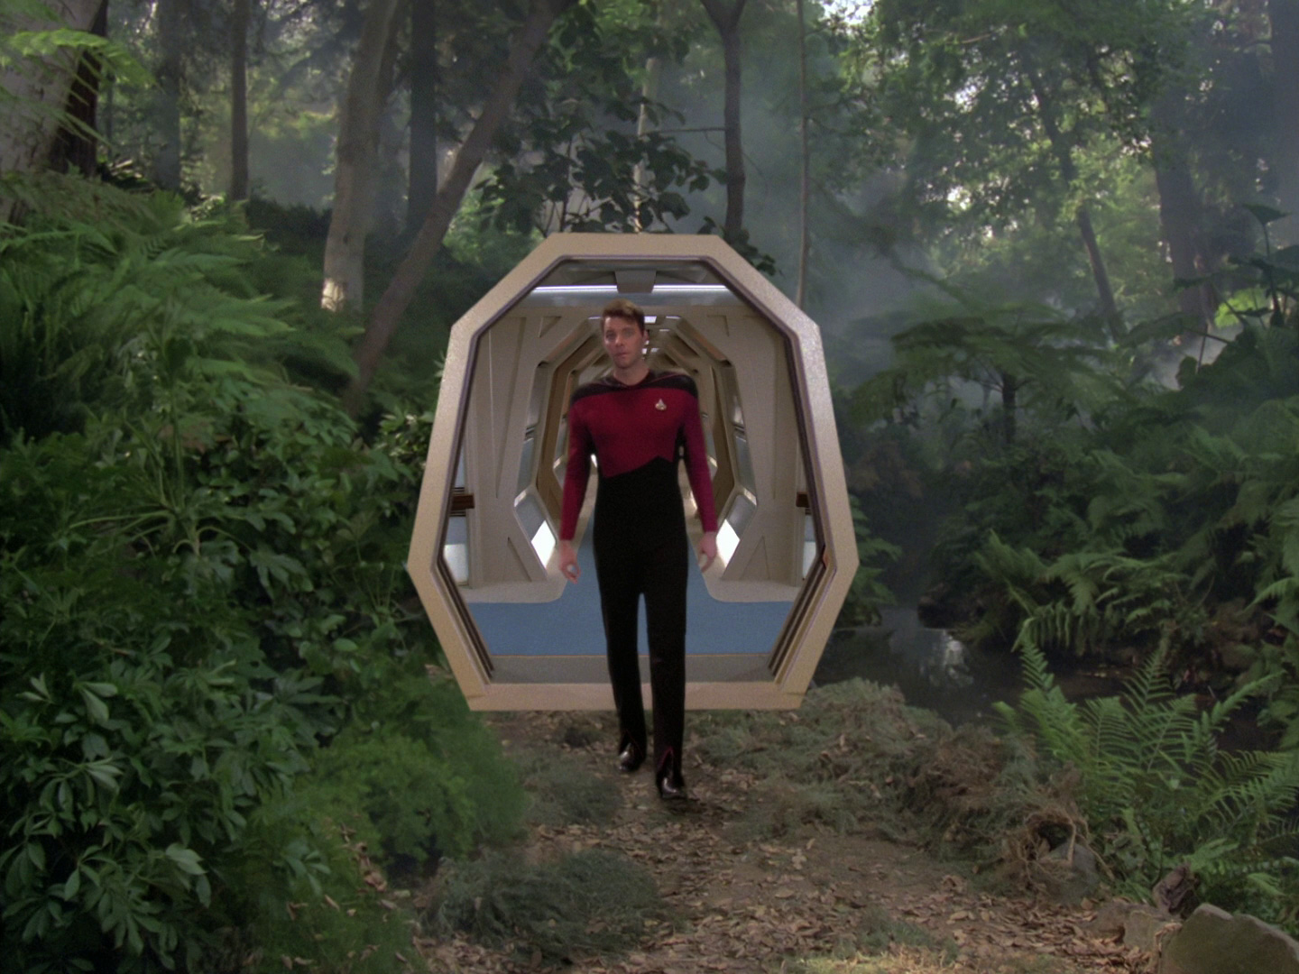
Exploring
Involves users moving through virtual or physical environments
Examples include:
  3D desktop virtual worlds where people navigate using mouse around different parts to socialize (e.g., Second Life)
  CAVEs (Cave Automatic Virtual Environment) where users navigate by moving whole body, arms, and head in an environment simulated using projectors.
  Physical context aware worlds, embedded with sensors, that present digital information to users at appropriate places and times
http://www.id-book.com
Notes:
41

Slide 42
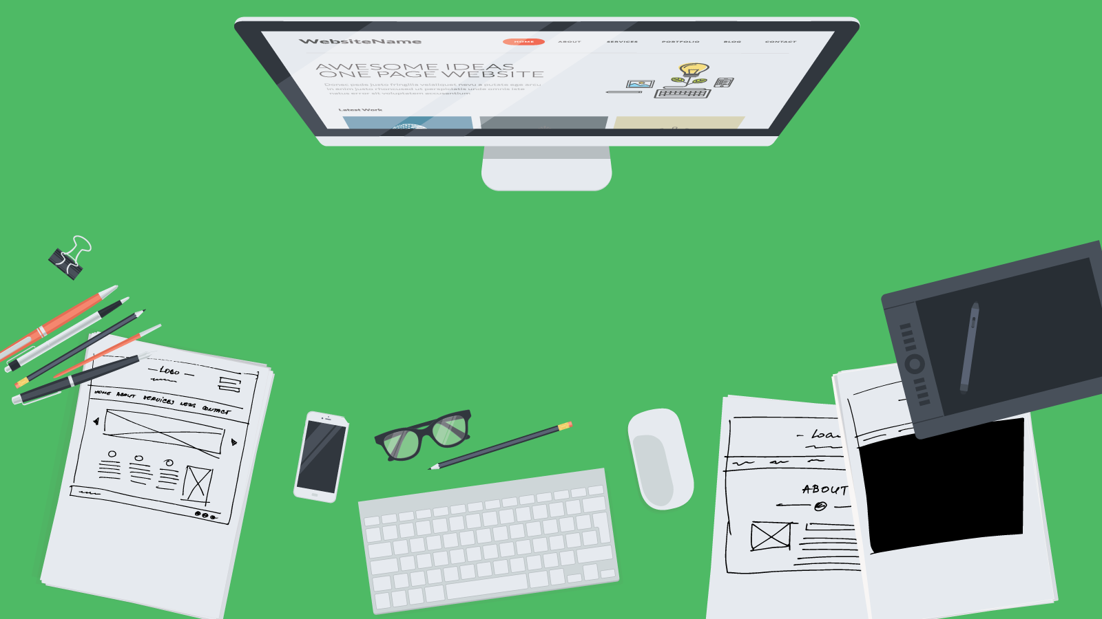
Summary
Design Principles
  Visibility, Feedback, Constraints, Consistency, Feedback,
The Design Process
  Conceptual Model
  Metaphors
Interaction Types
  Instructing
  Conversing
  Manipulating and Exploring
http://www.id-book.com

Slide 43
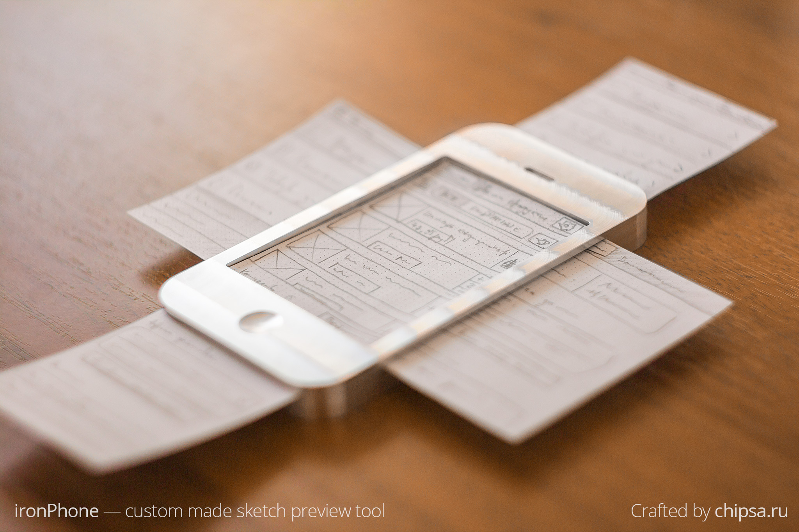
Prototyping

Slide 44
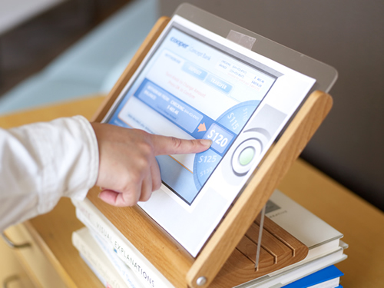
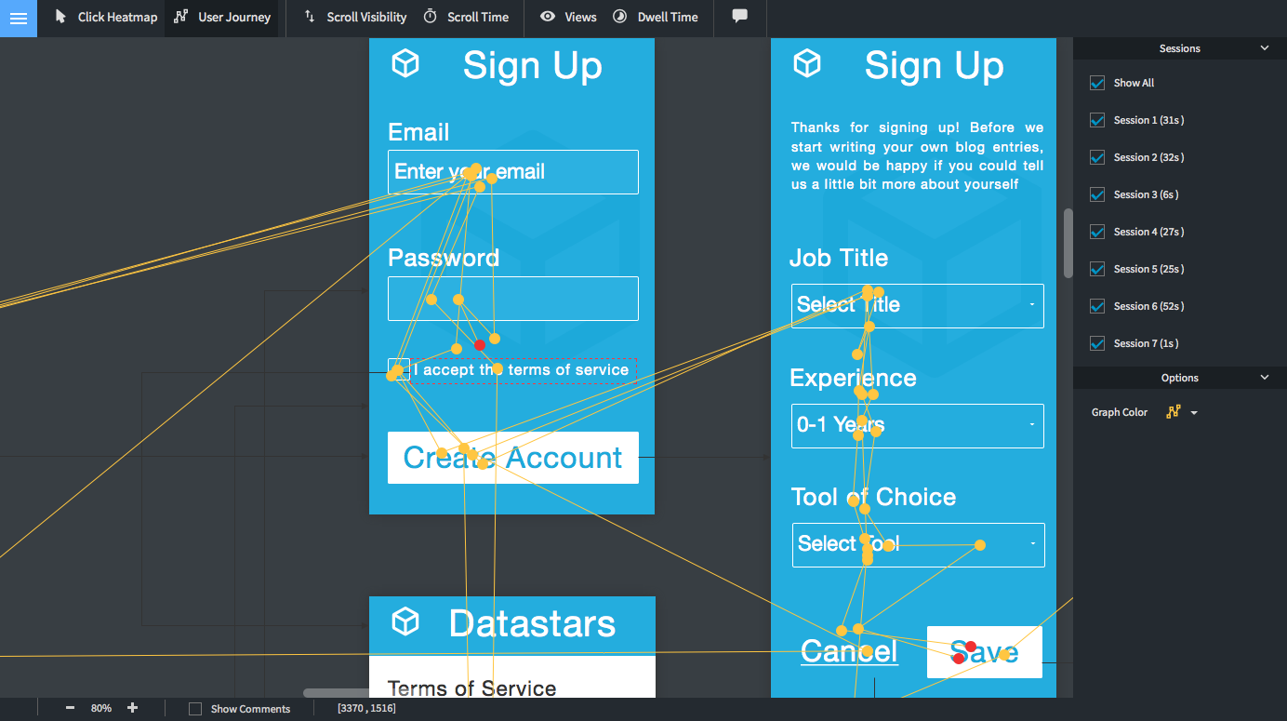
Prototyping and Construction
What is a prototype?
Why prototype?
Different kinds of prototyping
low fidelity
high fidelity
Compromises in prototyping
vertical
horizontal
Construction
http://www.id-book.com

Slide 45
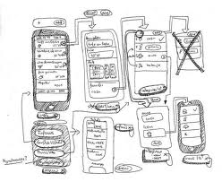
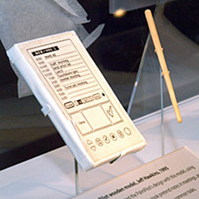
What is a Prototype
An early small-scale model of the intended interface.
May take the form of:
  a series of screen sketches
  a storyboard, i.e. a cartoon-like series of scenes
  a PowerPoint slide show
  a video simulating the use of a system
  a lump of wood (e.g. Palm Pilot)
  a cardboard mock-up
  a piece of software with limited functionality written in the target language or in another language
http://www.id-book.com

Slide 46
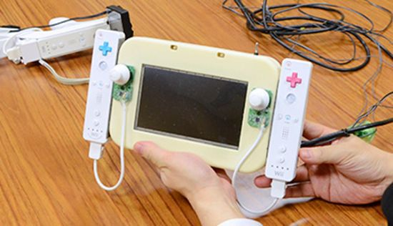
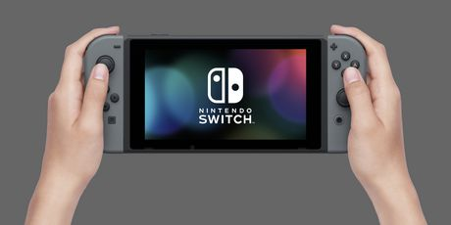
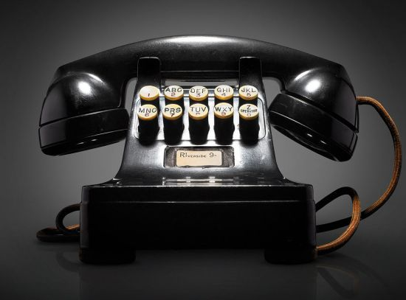
Why Prototype
Evaluation and feedback are central to interaction design
Stakeholders can see, hold, interact with a prototype more easily than a document or a drawing
Team members can communicate effectively
You can test out ideas for yourself
It encourages reflection: very important aspect of design
Prototypes answer questions, and support designers in choosing between alternatives
http://www.id-book.com

Slide 47
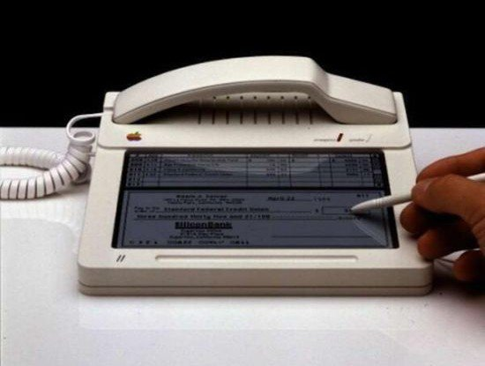
Principles of Prototypes (Lim et Al.)
Fundamental Principle: Filters the qualities that designers are interested in (without distorting the understanding of the whole).
Economic Principle: “The best prototype is the one that, in the simplest and most efficient way, makes the possibilities and limitations of a design idea visible and measurable.”

Slide 48
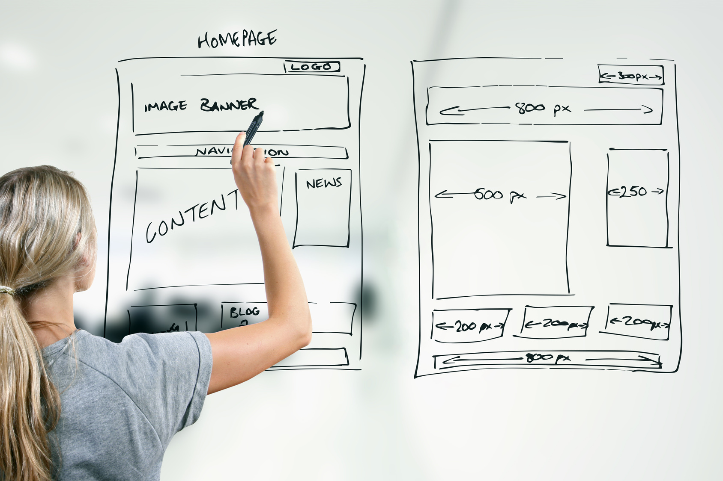
What to prototype
Technical Issues
Work flow, task design
Screen layouts and information display
Difficult, controversial, critical areas.

Slide 49
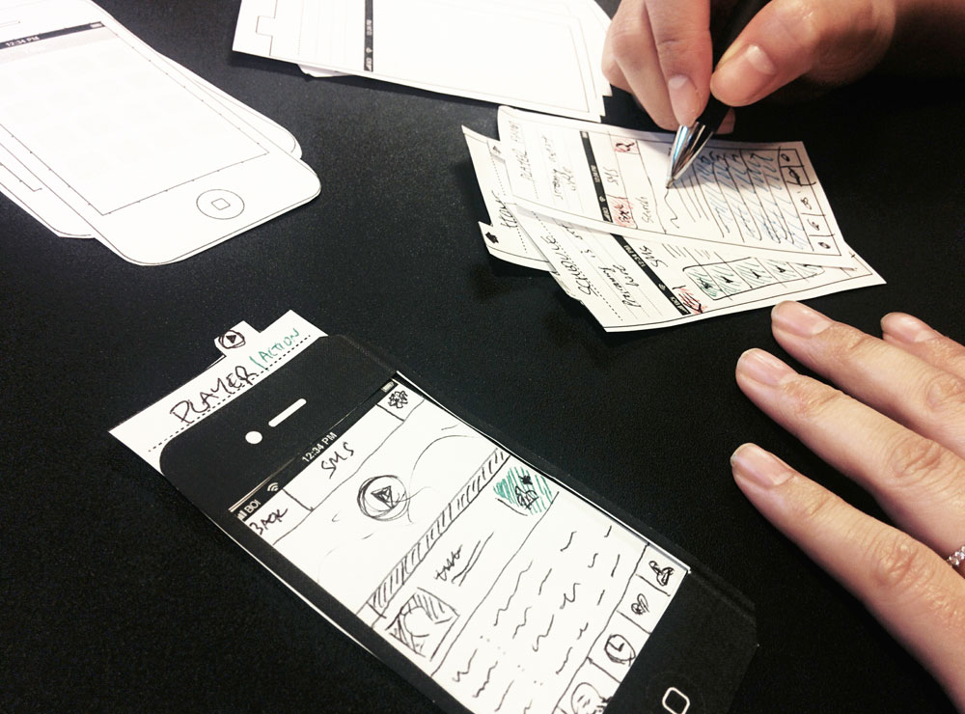
Low-Fidelity Prototyping
Uses a medium which is unlike the final medium, e.g. paper, cardboard
Is quick, cheap and easily changed
Examples:
sketches of screens, task sequences, etc
‘Post-it’ notes
storyboards
‘Wizard-of-Oz

Slide 50
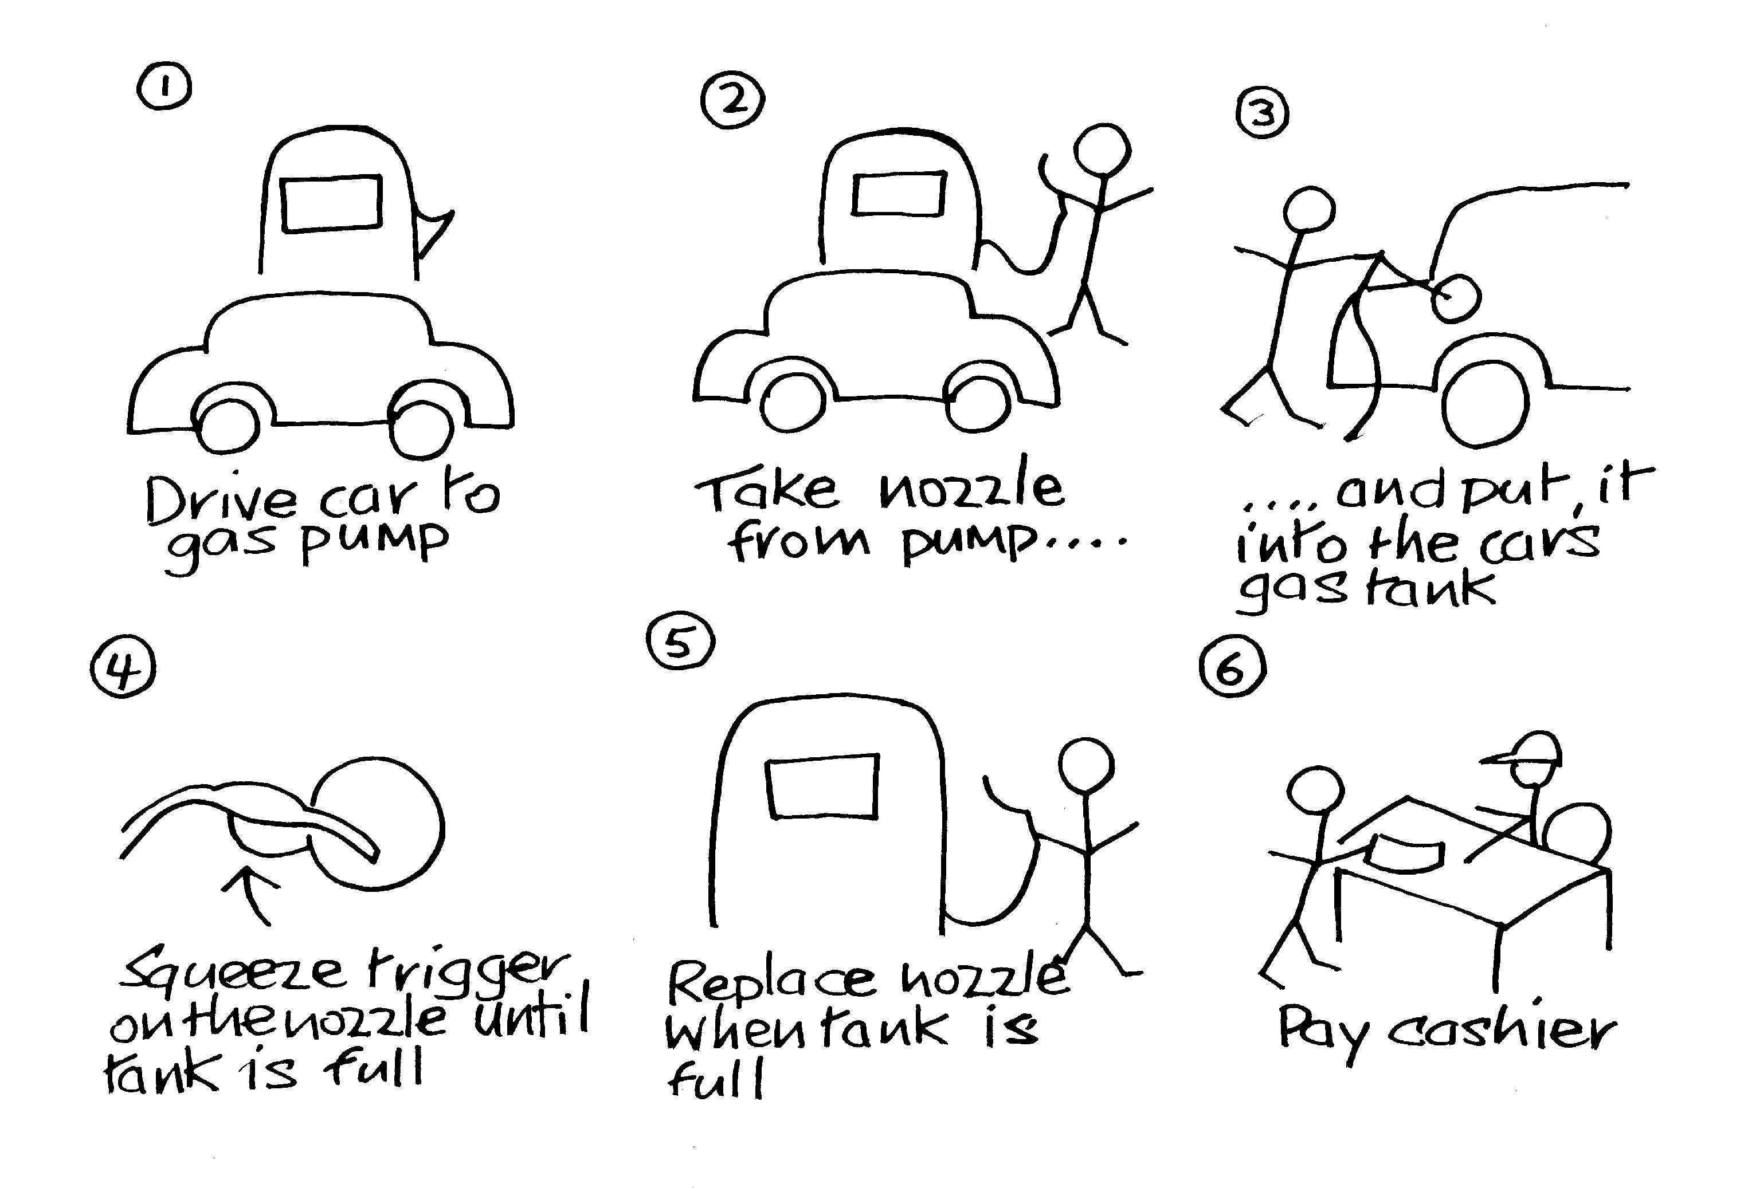
Storyboards
Often used with scenarios, bringing more detail, and a chance to role play
It is a series of sketches showing how a user might progress through a task using the device
Used early in design
No need to be
Michelangelo!
Can use tool:
https://storyboardthat.com

Slide 51
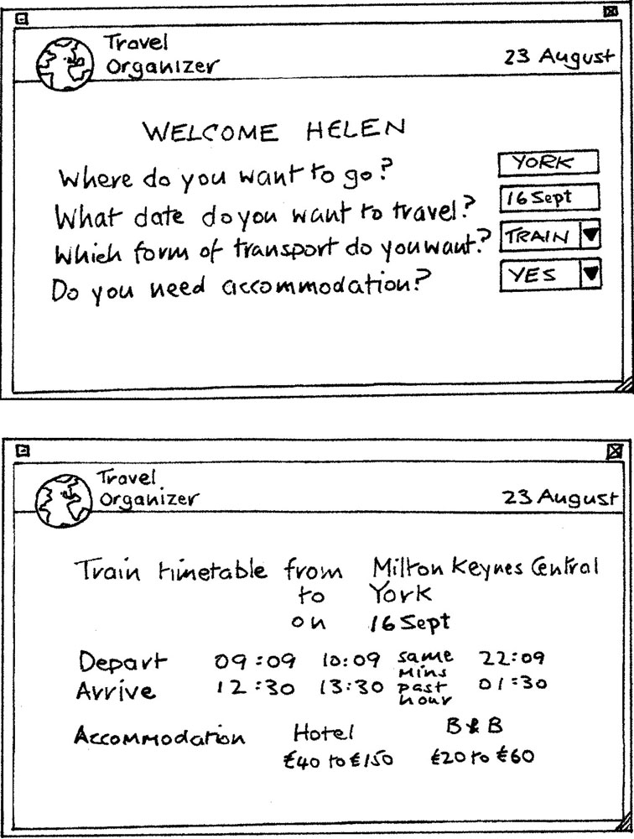
Card-based Prorotypes
Index cards (3 X 5 inches)
Each card represents
one screen or part of screen
Often used in website
development

Slide 52
Wizard-of-OZ prototyping
The user thinks they are interacting with a computer, but a developer is responding to output rather than the system.
Usually done early in design to understand users’ expectations.
User
>Blurb blurb
>Do this
>Why?

Slide 53
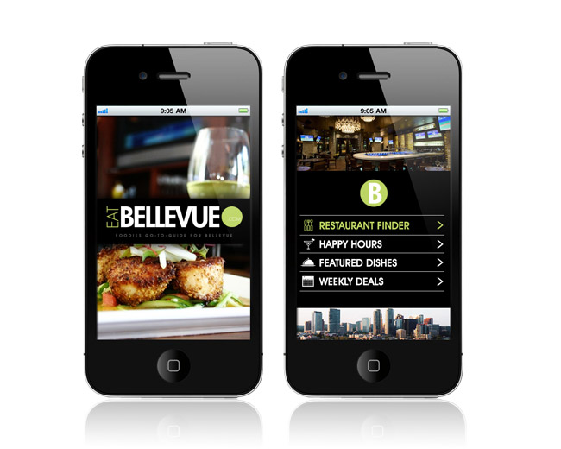
High-fidelity Prototyping
Uses materials that you would expect to be in the final product.
Prototype looks more like the final system than a low-fidelity version.
For a high-fidelity software prototype common environments include Adobe Director, Flash Professional, Visual Basic and several on-line systems (e.g. invision, proto.io).

Slide 54


Compromises in Prototyping
All prototypes involve compromises
For software-based prototyping maybe there is a slow response? sketchy icons? limited functionality?
Two common types of compromise
  horizontal: provide a wide range of functions, but with little detail
  vertical: provide a lot of detail for only a few functions
Compromises in prototypes must always be considered when evaluting results from user studies.

Slide 55


Construction
Evolutionary Prototype:
  Will evolve in the actual system.
  Happens in the context of e.g. agile methods.
  Maintainability of the code, style, design patterns and testing count from the start, which makes it possible to evolve the prototype into a fully featured product.
Throw-away prototype:
  Will serve its purpose but will then be replaced by the actual system.
  Why? Knowing that it's throw-away code helps focus on the actual features, while not worrying about maintainability of the code, style, design patterns or testing. This makes it possible to finish the prototype fast.
stackexchange.com

Slide 56

Overview
Design Principles
  Visibility
  Consistency
  Feedback
The Design Process
  Conceptual Model
  Metaphors
Interaction Types
  Instructing
  Conversing
  Manipulating and Exploring
Prototyping
http://www.id-book.com

